Slide 1
Steps towards usable verification
Francesco Logozzo, MSR Redmond
MSR: M. Fahndrich, M. Barnett, T. Ball, S. Lahiri
(Great) interns: P. & R. Cousot, M. Bouaziz, J.-H. Jourdan, V. Laviron,
S. Blackshear , S. Carr

Slide 2
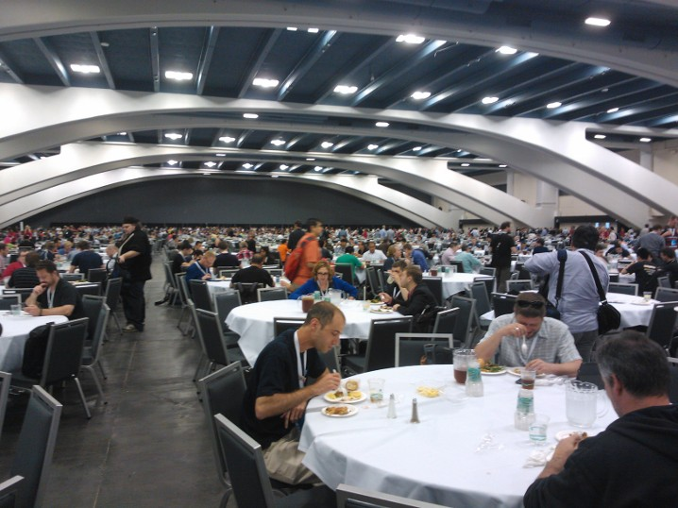

Slide 3
Vision: Usable Verification
Goal: Verification part of the software engineers’ everyday activity
Dream: Verification as easy to use as a compiler or as unit testing
Main Challenges
Practical specification languages
Meaningful (to the programmer) specification language
Effective verification tools
Tools should assist the programmer, not the other way around
Minimal changes to the build environment, be automatic, scale up, …
Scale: tenths of thousands of classes, hundreds of projects …

Slide 4
Problem #1: Writing Specifications
Programmers already write specifications
Parameter validations, DataContracts and all kind of attributes in .net code
Want to write more expressive specifications, e.g., Contracts
Contracts = Preconditions, Postconditions, Object invariants
Usual solution: Change the language
Pro: Contracts first class citizens in the language
Nice syntax, keywords …
Con: Require new language (Eiffel) or compiler (Spec#, JML)
Unlikely to happen in industrial setting
Pragmatic solution: Extend language via a library
Use code to specify code

Slide 5
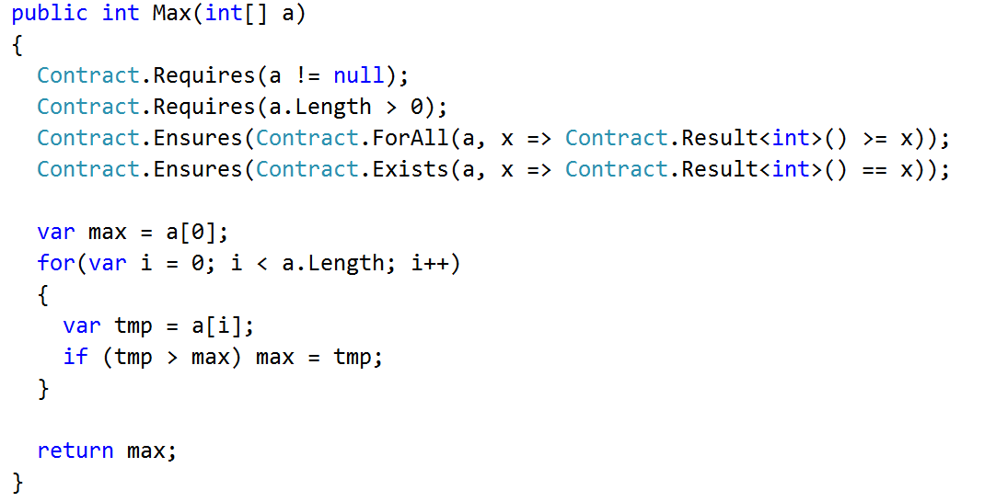
Specifications with CodeContracts
API defined in mscolib
Preconditions
Postconditions (with quantifiers)
Name the result

Slide 6
CodeContracts for specification
Pros: Very pragmatic
No need for new language/compiler
Specification are method calls
Clear and defined semantics
Given by the compiler
Leverage IDE/Support
Intellisense, type checking etc.
Cons: Lost beauty
More verbose

Slide 7
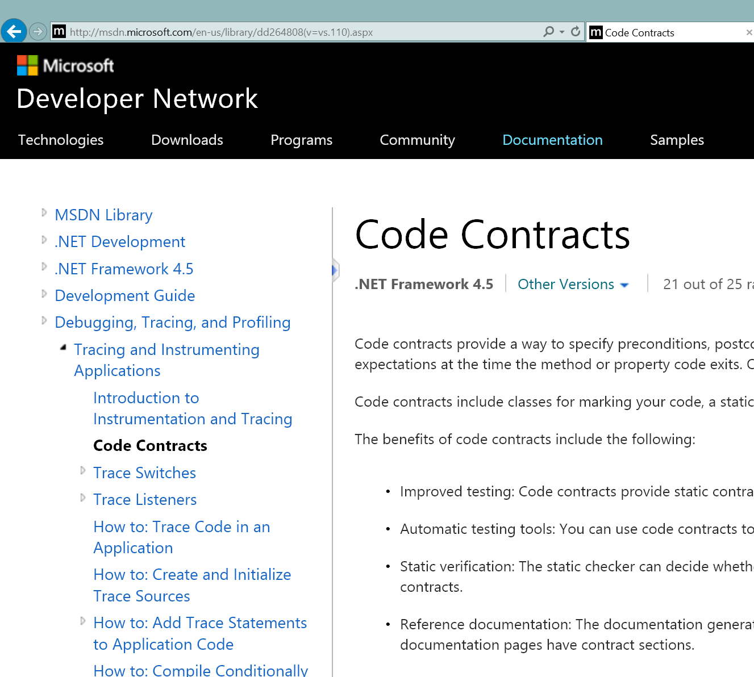
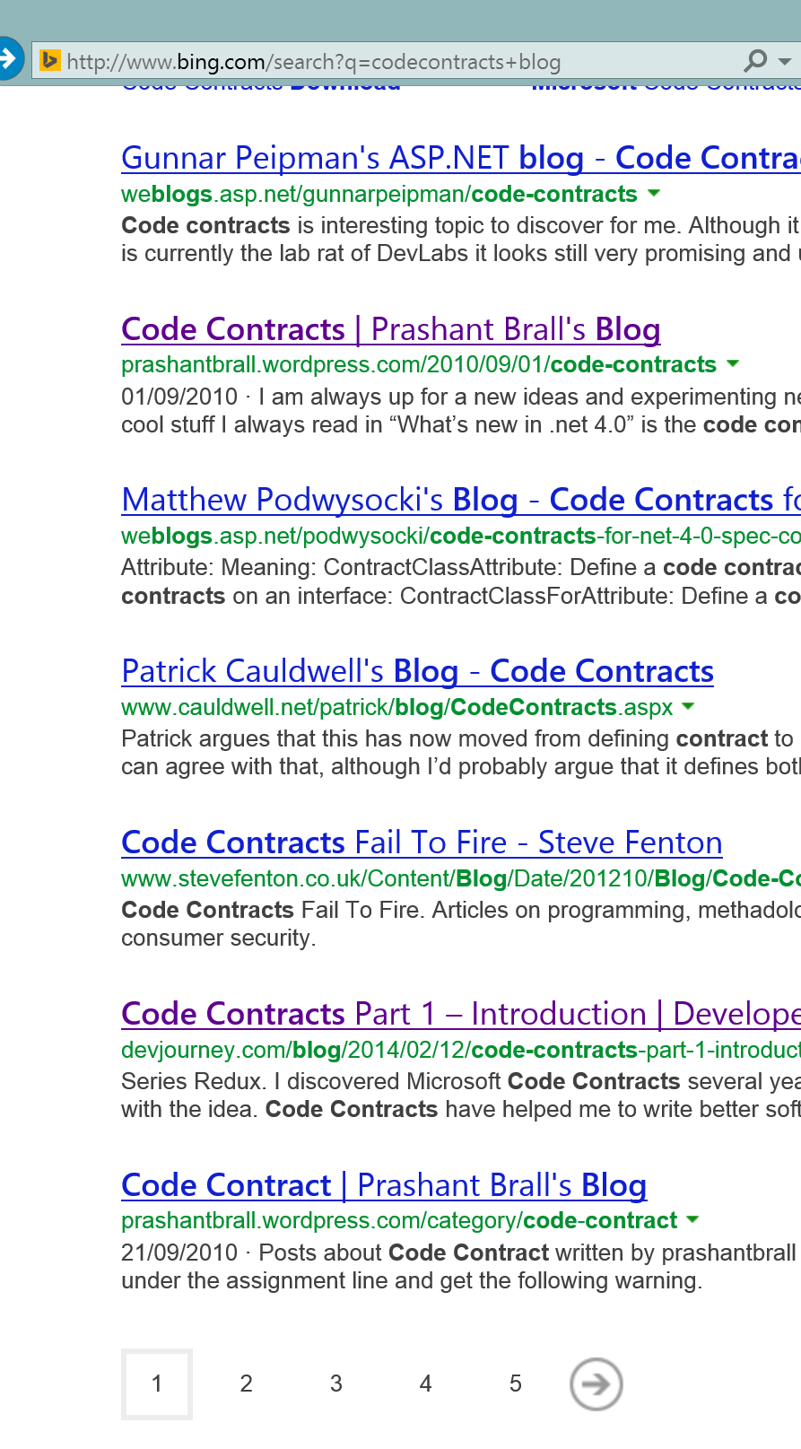
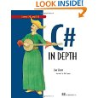

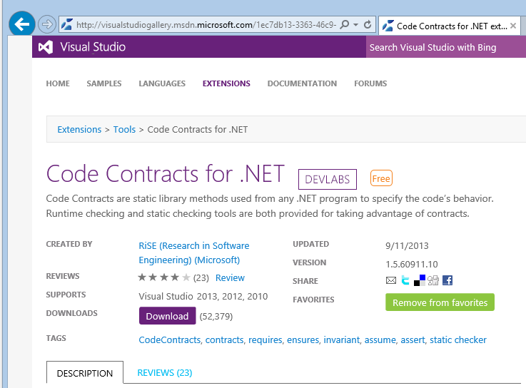
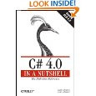
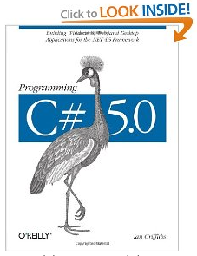
CodeContracts Status
Specification API standard in .net
Since v.4.0
Internal & external adoption
Core MS software written with CC
Popular
Many blogs, book chapters, articles …
Thousands posts in forum, StackOverflow
Tools integrate in Visual Studio
> 150K downloads
Compile time analysis

Slide 8
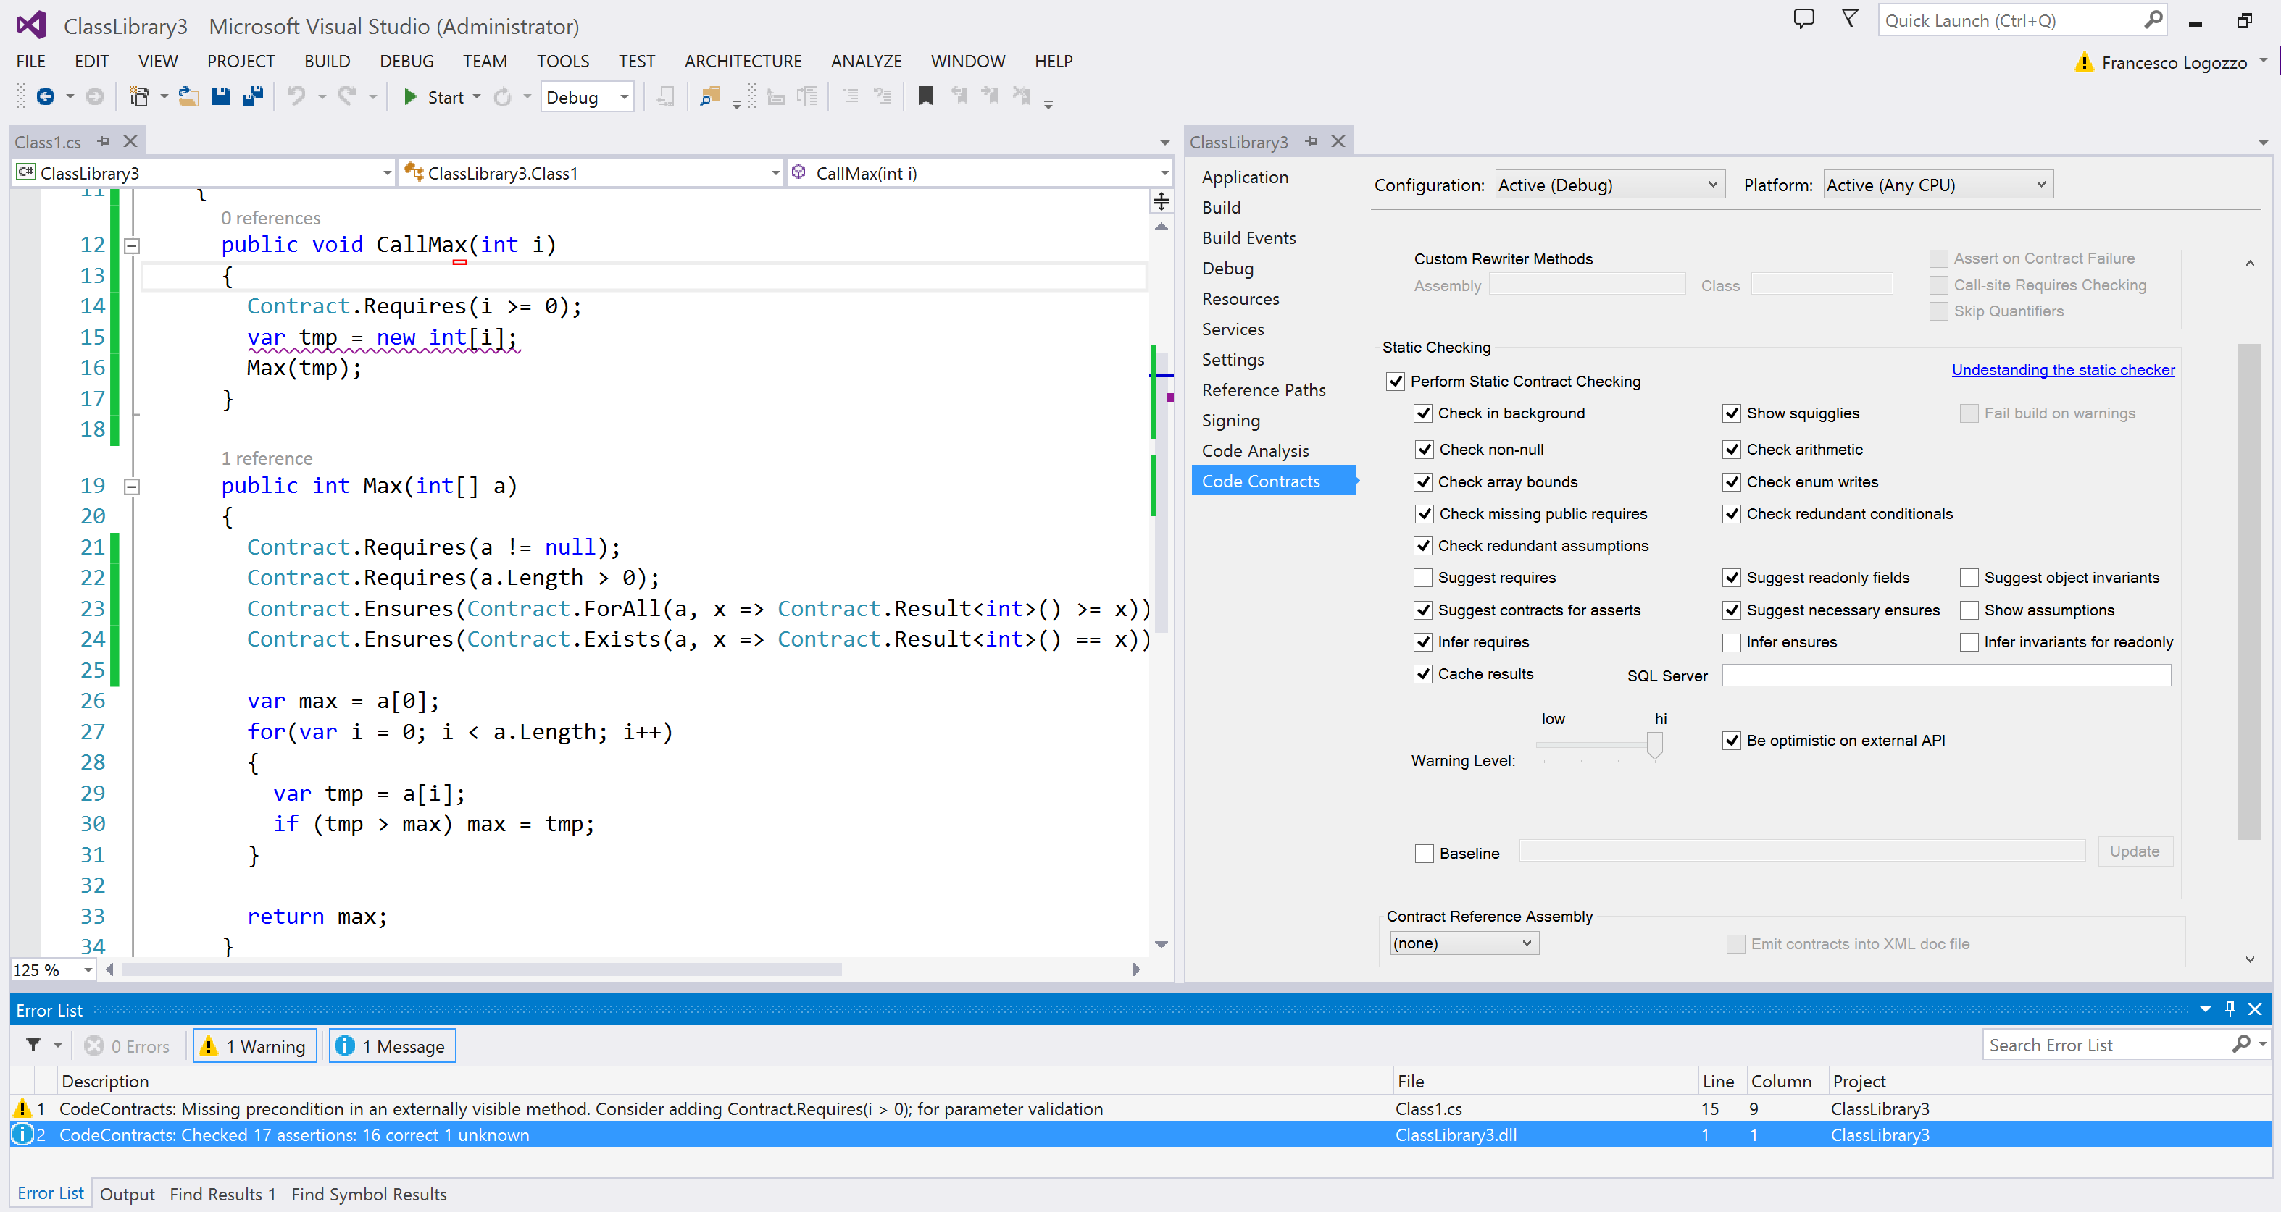
Enable from VS
Prove assertions
Report too weak pre

Slide 9
Contract Checking
Runtime checking
Via binary rewriting
Insert postconditions at exit points, inherit contracts …
Custom behavior on contract failure
Not in this talk ;-)
Static checking
Via abstract interpretation
The rest of this talk…

Slide 10
FAQ: Why Abstract interpretation?
Infer the loop invariant
a ≠ null ∧ 0 < a.Length ∧ 0 ≤ i ≤ a.Length ∧ ∀ j. 0 ≤ j < i. a[i] ≤ max ∧ ∃ j. 0 ≤ j < i. a[j] = max

Slide 11
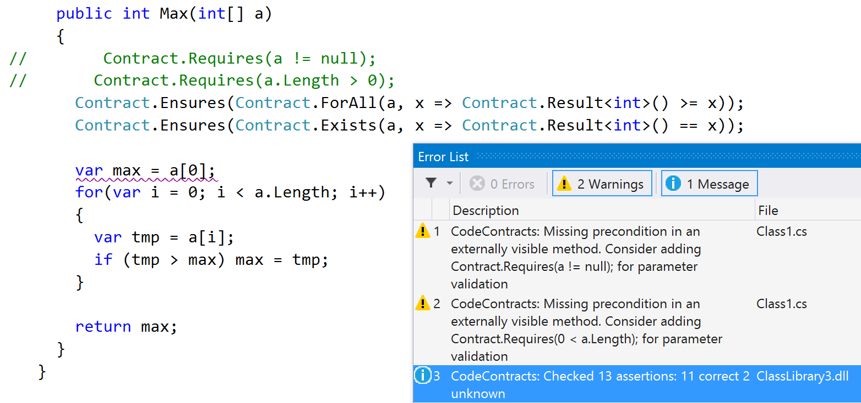
Infer precondition

Slide 12
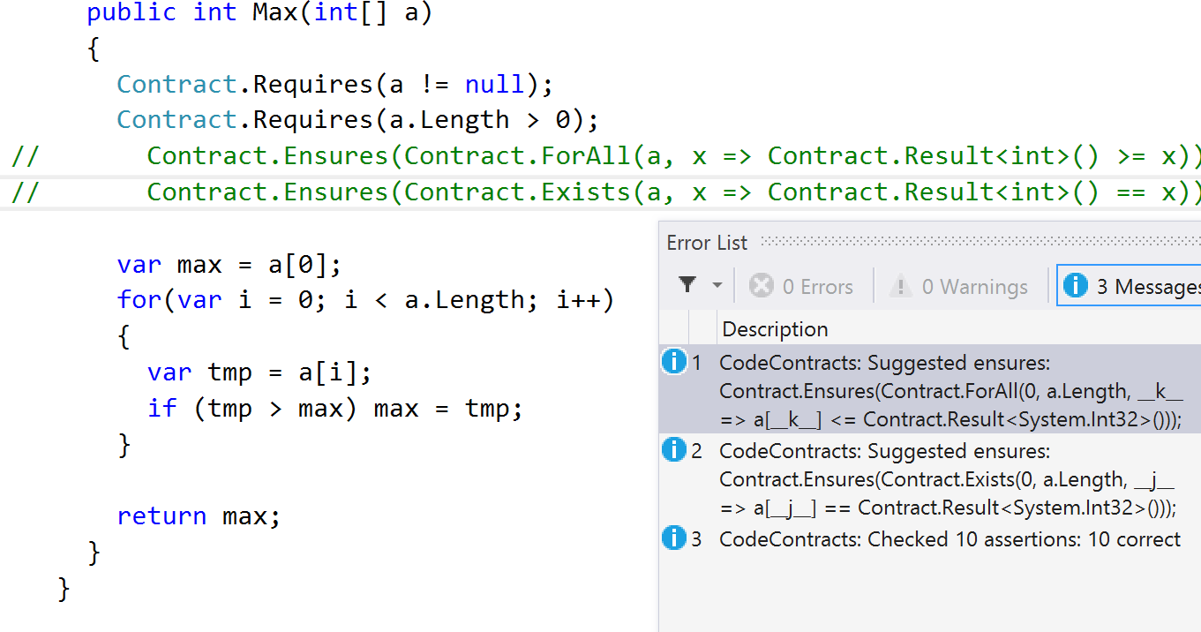
Infer postcondition

Slide 13
Why abstract interpretation?
> cccheck.exe @Domino.Transformers.Runners.rsp –select 633
Microsoft (R) .NET Contract Checker Version 1.7.10825.13
Copyright (C) Microsoft Corporation. All rights reserved.
Method 625 : Domino.Transformers.Runners.Cl.ClRunner.SelectAnOptimizationOption(…)
Method stats: #Inst: 733, #joins: 75, #loops: 0
...
Method 633 : Domino.Transformers.Runners.Cl.ClRunner.EvaluateOneSourceFile(…)
Method stats: #Inst: 17188, #joins: 1708, #loops: 18
...
Total methods analyzed 9
Total time 1:15min. 8357ms/method
…
Domino.Transformers.Runners.dll : Checked 880 assertions: 880 correct

Slide 14

High level view of Clousot
Assertion violations
add
contracts
infer
invariants
check
⇒
generate
report
Dead Code
Code repairs
Contract inference
Use more refined
abstract domain
semantic
hash
save
into cache
M. Fahndrich, F. Logozzo, Static contract checking with Abstract Interpretation, FoVeOOS 2010

Slide 15
FAQ: Do you use an SMT solver?
NO. Why?
Performance: conversion from abstract domains to SMT format, inter-proc calls …
Non-determinism: randomization, time-outs
Predictability: Small program changes should not change output
Semantics: Different tools make different assumptions (e.g., on Int32, Floats …)
Modelling: How to effectively model all .net metadata?
Overdoing: Do not have assertions like ∀y ∃x …
….

Slide 16
Abstract domains in Clousot
Basic domains
IL decompilation, Expression recovery, Optimistic heap analysis, Nullness
Advanced domains
Numerical
Dis-Intervals, Pentagons, Subpolyhedra, (simple) Floating points …
Collections
Functor for arrays, ∀/∃-Quantifiers, array modifications …
Others
“lazy” trace partitioning, Enums, strings …
P. Cousot, R. Cousot, F. Logozzo, A Parametric Segmentation Functor for Fully Automatic and Scalable Array Content Analysis, POPL’11
V. Laviron F. Logozzo, SubPolyhedra: A (more) scalable approach to infer linear inequalities, VMCAI’11
P. Ferrara, F. Logozzo, M. Fähndrich, Safer unsafe code for .NET, OOPSLA’08
….

Slide 17
Inter-procedural inference

Slide 18
Inference of contracts
Ideally the software engineer provides all the boundary contracts
As she does with types today
In practice she only provides “few”, the one she thinks are interesting
If the tool cannot infer “evident” contracts then it is labeled as “dumb”
E.g. return new A()
The tool should help the programmer not the other way around
Clousot infers
Necessary preconditions and object invariants
“Easy” postconditions

Slide 19
Intermezzo: Necessary and sufficient
In S ⟹ N we say that
S in a sufficient condition for N
N is a necessary condition for S
For a program P
A condition S is sufficient if its truth ensures that P is correct
A condition N is necessary if its falsehood ensures P is incorrect

Slide 20
Inference of preconditions
Define: What is a precondition?
Sufficient precondition: if it holds, the function is correct
Necessary precondition: if it does not hold, the function is definitely wrong
When automatic inference is considered, only necessary preconditions make sense
Sufficient preconditions impose too large a burden to callers
Should be under-approximated in presence of loops
Necessary preconditions are easy to explain to users
Should be over-approximated
They are conditions to errors
P. Cousot, R. Cousot, F. Logozzo: Precondition Inference from Intermittent Assertions and Application to Contracts on Collections. VMCAI’11
P. Cousot, R. Cousot, M. Fahndrich, F. Logozzo, Automatic Inference of Necessary Preconditions, VMCAI’13
M. Bouaziz, F. Logozzo, M. Fahndrich, Inference of Necessary Field Conditions with Abstract Interpretation, APLAS’12

Slide 21
Example
The necessary and sufficient precondition is
x < 0 || a != null
A sufficient precondition
a != null
Too strong for the caller
No runtime error when x < 0 and a == null
E.g.: Example(-2, null);
Clousot users complained about it
“wrong preconditions”
int Example(int x, object[] a)
{
if (x >= 0)
{
return a.Length;
}
return -1;
}
Hard to get a sufficient and necessary with loops and non-determinism

Slide 22
Necessary preconditions in Clousot
All-Paths precondition analysis
Hoists unmodified assertions to the code entry
Infers: a != null
Conditional-path precondition analysis
Hoist assertions by taking into account tests/loops
Use dual-widening for loops
Infers: a.Length > 0
Quantified precondition analysis
Deal with unbounded data structures
∃ j ∈ [0, a.Length). a[j] == 3
int FirstOccurence(int[] a)
{
int i = 0;
while (a[i] != 3)
i++;
return i;
}

Slide 23
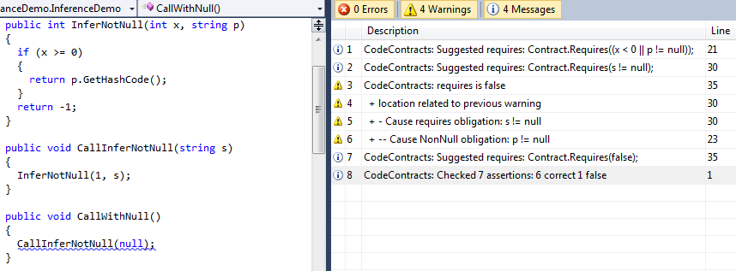
Precondition inference & propagation

Slide 24
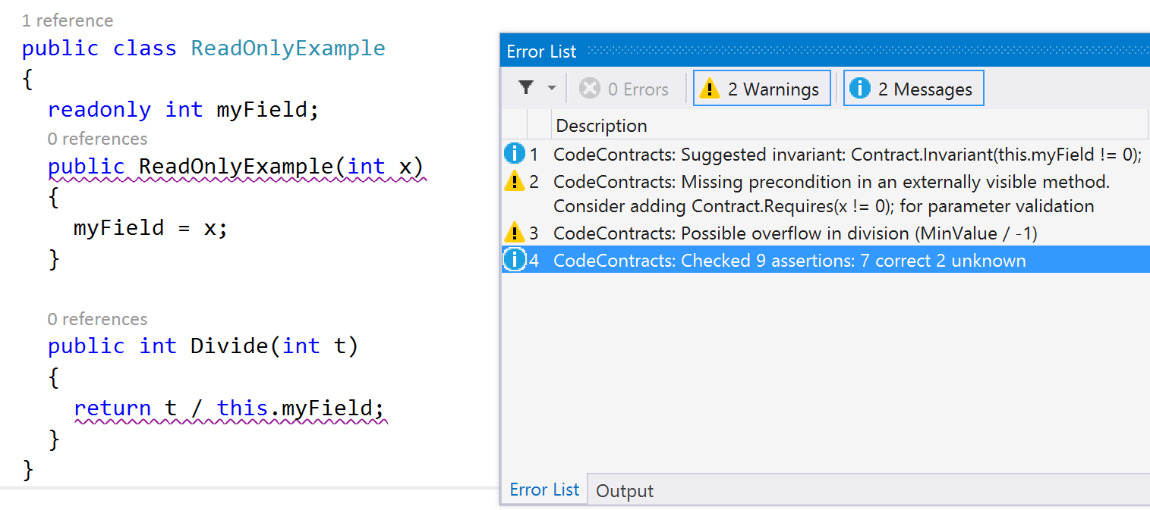
Object invariants inference
Infer object invariant
Infer pre
What about this?
M. Bouaziz, F. Logozzo, M. Fahndrich, Inference of Necessary Field Conditions with Abstract Interpretation, APLAS’12

Slide 25
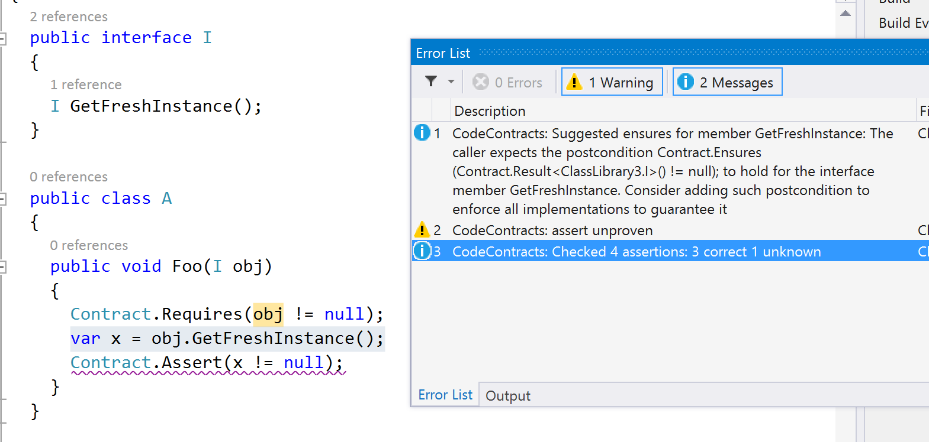
Postconditions inference
Infer post

Slide 26
Refactoring

Slide 27
Refactoring &(modular) proofs
public int Decrement(int x)
{
Contract.Requires(x >= 5);
Contract.Ensures(Contract.Result<int>() >= 0);
x = NewMethod(x);
return x;
}
private static int NewMethod(int x)
{
while (x != 0) checked(x--);
return x;
}
Postcondition: ok
public int Decrement(int x)
{
Contract.Requires(x >= 5);
Contract.Ensures(Contract.Result<int>() >= 0);
while (x != 0) checked(x--);
return x;
}
Refactor
Postcondition
Violation?
No overflow
Possible overflow

Slide 28
Conditions on the “extracted” contract
Should be a valid contract
Contract.Requires(x >= 5);
Contract.Ensures(Contract.Result<int>()==100);
The contract should imply safety Contract.Ensures(Contract.Result<int>() == 0);
It should be complete
Contract.Requires(x >= 5);
Contract.Ensures(Contract.Result<int>() <= x);
It should be general
Contract.Requires(x >= 5);
Contract.Ensures(Contract.Result<int>() == 0);
Invalid post
int Decrement(int x)
{
Contract.Requires(x >= 5);
Contract.Ensures(Contract.Result<int>() >=0);
x = NewMethod(x);
return x;
}
Exposes overflow
Wrong solutions
Can’t prove caller
int NewMethod(int x)
{
// ??? Which contract here ????
while (x != 0) checked(x--);
return x;
}
Not general

Slide 29
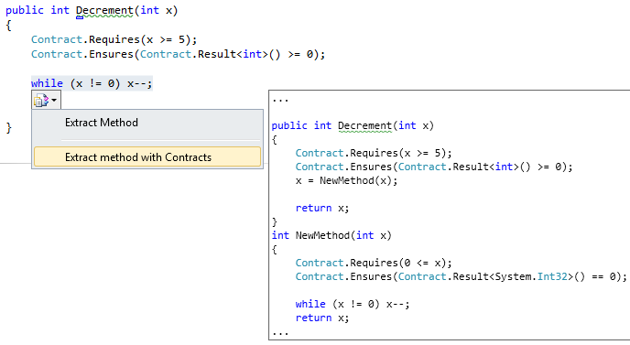
Our solution
P. Cousot, R. Cousot, F. Logozzo, M. Barnett,
An Abstract Interpretation Framework for Refactoring with Application to Extract Methods with Contracts, OOPSLA’12

Slide 30
Dealing with warnings…

Slide 31
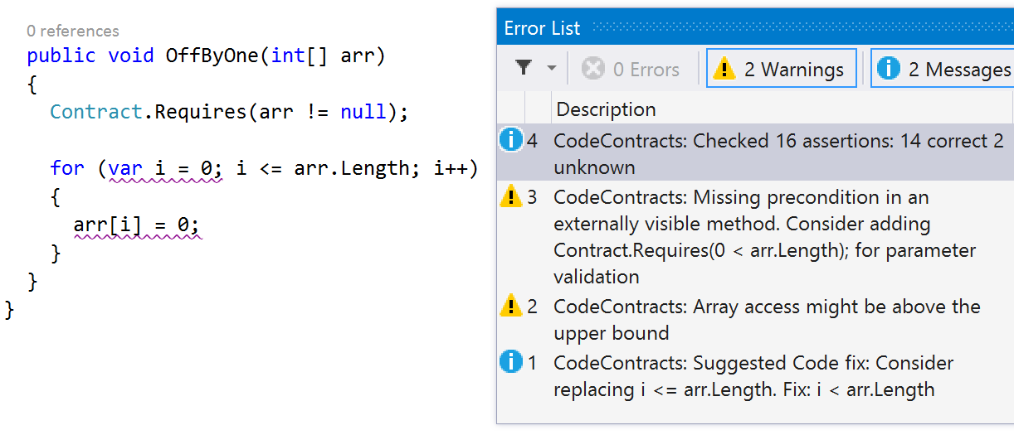
Code Repairs
Alarm
Suggest fix

Slide 32
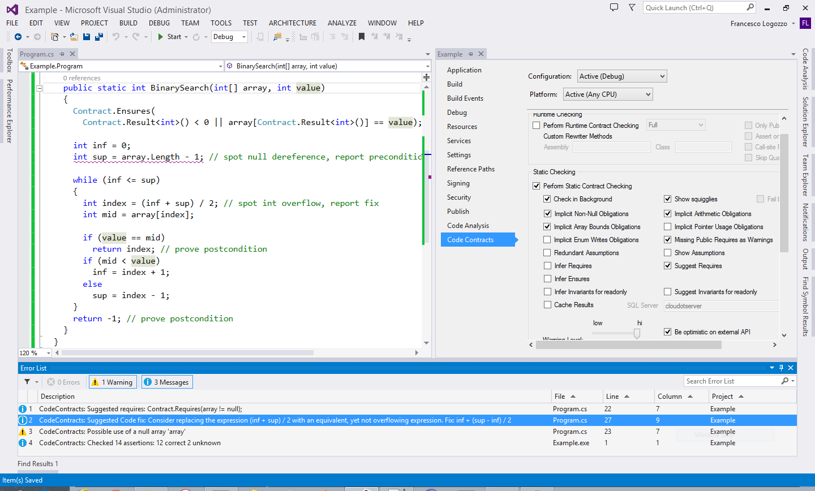
Repairing of overflows
Repairs in Clousot
Constant and object initialization
Guards
Buffer overflows
Arithmetic overflows
Floating point comparisons
…
0 ≤ inf ≤ sup < array.Length ≤ 2³¹-1
Possible overflow
Suggest repair!

Slide 33
Program analysis and Code repairs
Three components in program analysis program, specification, analysis result
The (usual) verification problem is
“Check that the analysis result guarantees that the program meets its specification"
The (new) verified code repair problem is
“Refine the program using the analysis result so that it meets its specification”
Related, but different than program synthesis
A verified repair reduces the bad runs, while increasing the good runs
Up to an observation, i.e., abstraction
In practice, verified repairs are abstract-domain specific
F. Logozzo and T. Ball, Modular and Verified Automatic Program Repair, OOPSLA'12
F. Logozzo and M. Martel, Automatic Repair of Overflowing Expressions with Abstract Interpretation, in Festschrift for Dave Schmidt, 2013

Slide 34
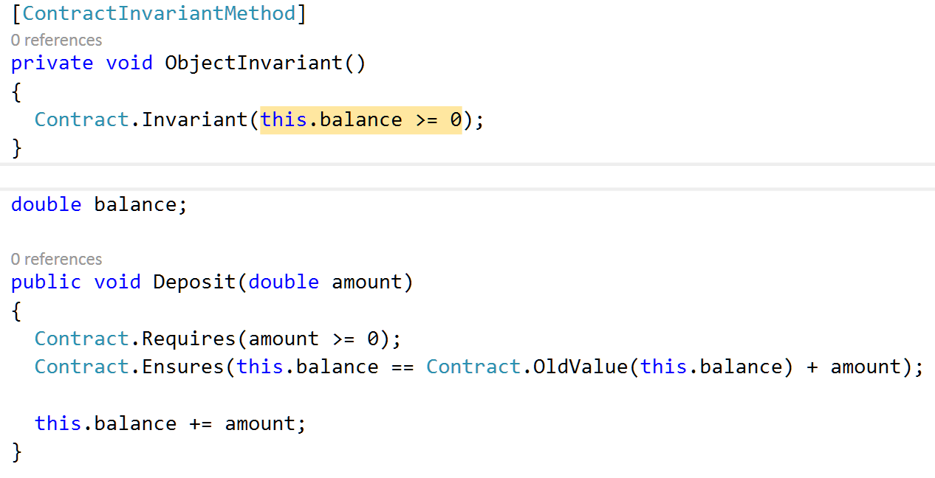
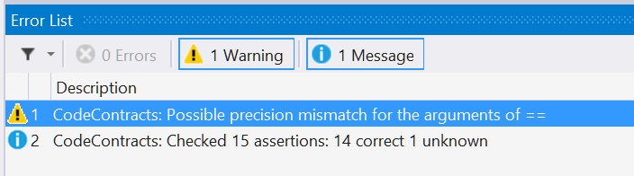
Example: Repairing Float comparisons

Slide 35
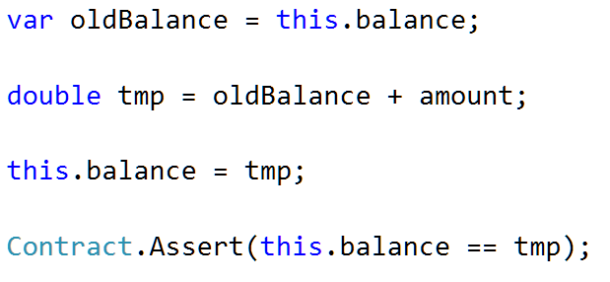
Repairs from analysis
⊤
f64
f64
f32
f64
fext
fext
f64
fext
f64
fext
⊥
f64
fext
Suggested repair:
M. Fähndrich, F. Logozzo: Checking Compatibility of Bit Sizes in Floating Point Comparison Operations. TAPAS 2012

Slide 36
Dealing with unknown libraries

Slide 37
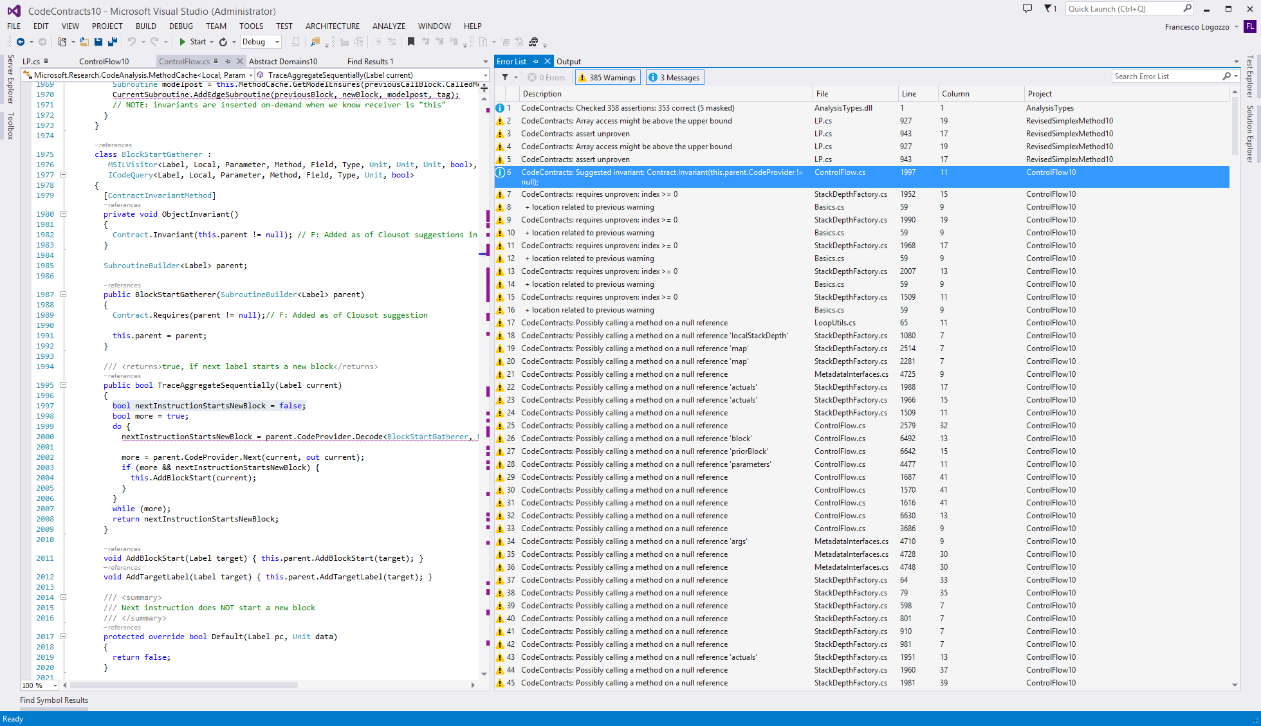
Too many warnings
Because of missing contracts on
external libs
Notes:
Now, what is the problem? Take your program or library, run cccheck and you get many, many warnings!

Slide 38


VMV: Verification modulo versions
P
Base version
P’
New version
Instrument
P’+C
Instrumented
Analyze
Analyzer is a black box
Reduce alarms up to 70%
With semantic guarantees!!!
Analyze
Extract semantic conditions C
F. Logozzo, S. Lahiri, M. Fahndrich, S. Blackshear, Verification Modulo Versions: Towards Usable Verification, PLDI’14

Slide 39
VMV(S): Finding regressions
Base version
Instrumented
new version
/// Get temperature in Kelvin
double GetCurrTemperature()
{
// In Celsius
1: var c = ReadTemperature();
2: var k = c + 273.15;
3: Contract.Assert(k >= 0);
4: return k;
}
/// Get temperature in Kelvin
double GetCurrTemperature()
{
// In Celsius
1: var c = ReadTemperature();
Contract.Assume(c >= -273.15);
2: var k = c + 273.0;
3: Contract.Assert(k >= 0);
4: return k;
}
Result(ReadTemperature) ≥ -273.15
Correct
⇔
c ≥ -273.15
Report regression!

Slide 40
VMV(N): Relative proofs
Base version
Instrumented
new version
/// Get temperature in Kelvin
double GetCurrTemperature()
{
// In Celsius
1: var c = ReadTemperature();
2: var k = c + 273.15;
3: Contract.Assert(k >= 0);
4: return k;
}
/// Get temperature in Kelvin
double GetCurrTemperature()
{
// In Celsius
1: var c = ReadTemperature();
Contract.Assume(c >= -273.15);
2: var k = c + 273.15;
3: var round = Math.Round(k, 2);
4: Contract.Assert(round >= 0);
5: return round;
}
Result(ReadTemperature) ≥ -273.15
Correct
⇔
c ≥ -273.15
Relative correctness

Slide 41
What semantic guarantees for P’?
Using sufficient conditions
All warnings in P’+ S are new alarms
S was sufficient to shut off all alarms in P
Each new alarm in P’+S is either
1. in new code or
2. S is not strong enough
Nothing can be said on the “verified” assertions
E.g., S can be too strong
VMV(S) useful for bug finding

Slide 42
What semantic guarantees for P’?
Using necessary conditions
All proven assertions in P’+ N are correct w.r.t. P
N holds in all good runs of P
Each proven assertion in P’+ N is either
1. because of an assume from N, or
2. absolute, i.e., without assumptions from P
Alarms may be new or old ones
E.g. N can be too weak
VMV(N) is useful for relative verification

Slide 43
Conclusions

Slide 44
Next generation static analyzers?
I took a vacation this week… I did not hear the word “cloud”
Computing is moving to the cloud
Development tools too
How do we engineer our systems to exploit the cloud?
New analyses algorithms,
Chaotic iterations, non-monotonic analyses
Sharing of computation, results
Collect data on static analysis usage, e.g., which bugs get fixed first?
…
M. Barnett, M. Bouaziz, M. Fahndrich, and F. Logozzo, A case for static analyzers in the cloud, in Bytecode 2013

Slide 45
Steps towards usable verification
Usable verification
Programmer friendly, precise, scales up, automatic
CodeContracts: They are real!!!
Specification with libraries
Part of .NET
Static verification with abstract interpretation
Contract inference
Code repairs
Verification modulo versions
Refactoring with Contracts

